Slide 1

Data Science Final Project
Group 1:
Vaibhav Chaudhari
Shan Jiang
Vedant Sanjay Murudkar
Sai Roshan Varma Pandati

Slide 2

Introduction
Health is a very important factor in every individual’s life. Having good health leads to longevity.
In US, NHE grew 9.7% to $4.1 trillion in 2020, or $12,530 per person, and accounted for 19.7% of GDP.
We want to find out what leads to an individual to have high health care costs.
The data we worked with contains details related to habits, personal details , and health care cost for individuals across some states in US.

Slide 3
Business Questions
What is the meaning of these variables in the Data?
What are the key variables that influence customer health care costs most?
How these variables influence customer health care costs, higher or lower?
Are we able to predict if an individual has an expensive health care cost?
What are some possible actions Health Management Organization can take to improve?

Slide 4
Demographics of Data
Age : 18 to 66
Location : only 7 states (Connecticut, Rhode Island, Massachusetts, Pennsylvania, Maryland, New Jersey, New York)
Population : Customers of the HMO

Slide 5
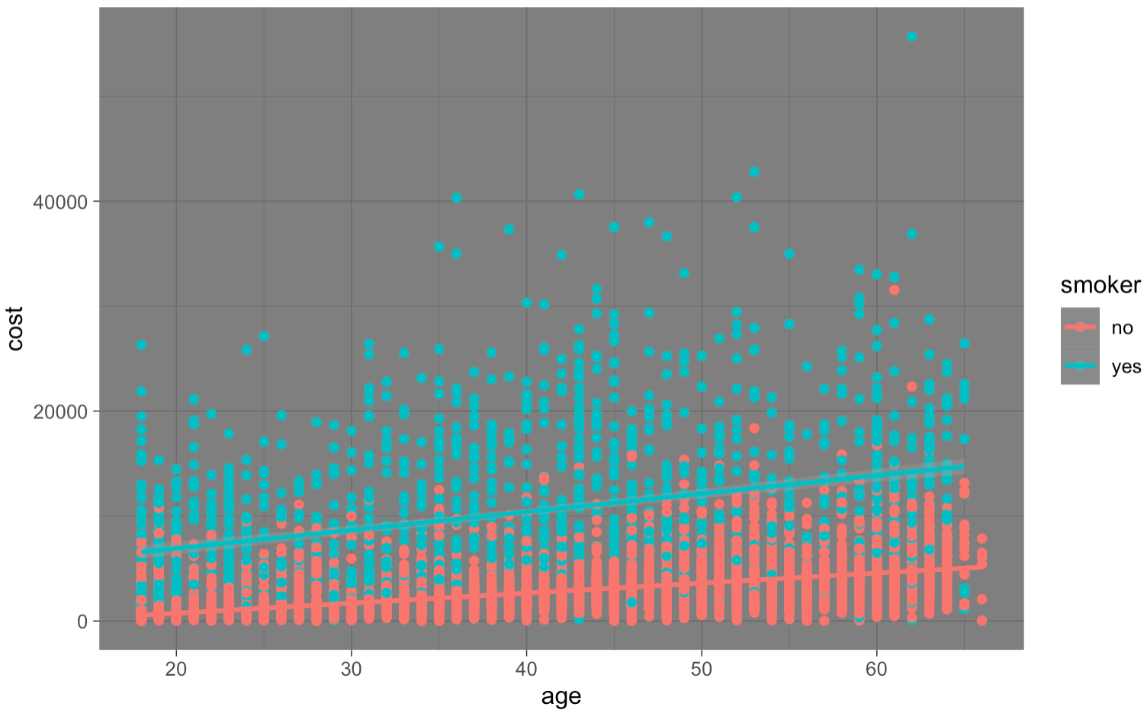
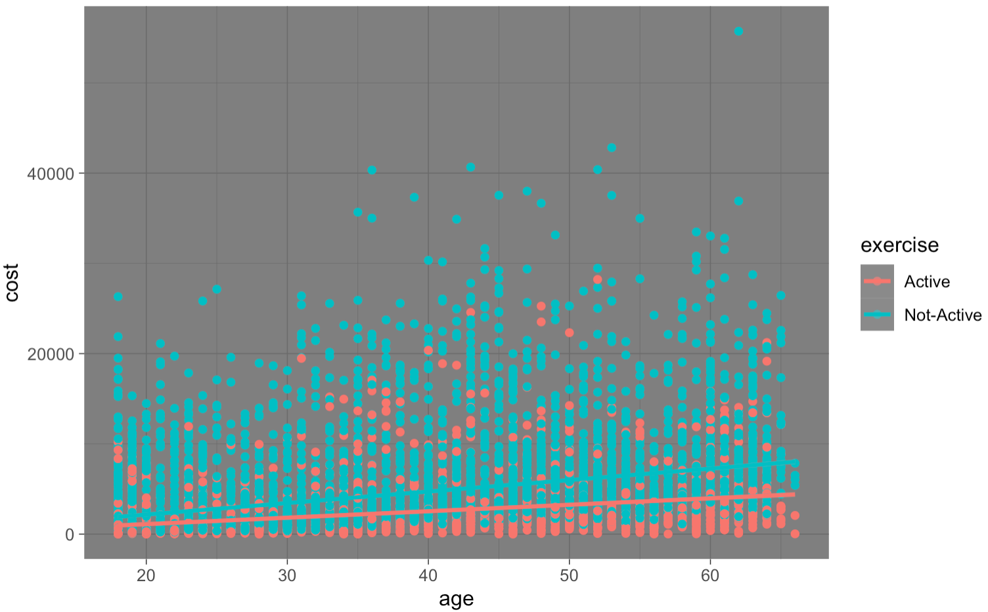
Insights
Age vs Cost
Smokers
Exercise

Slide 6
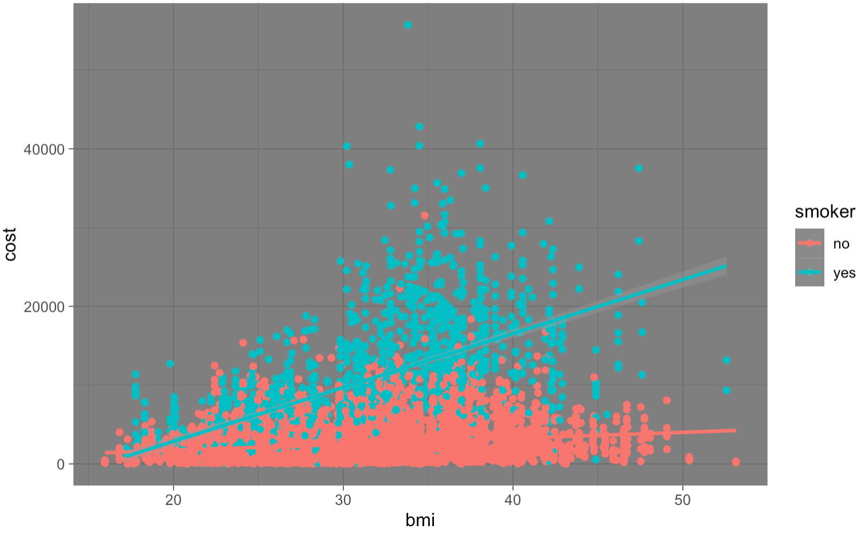
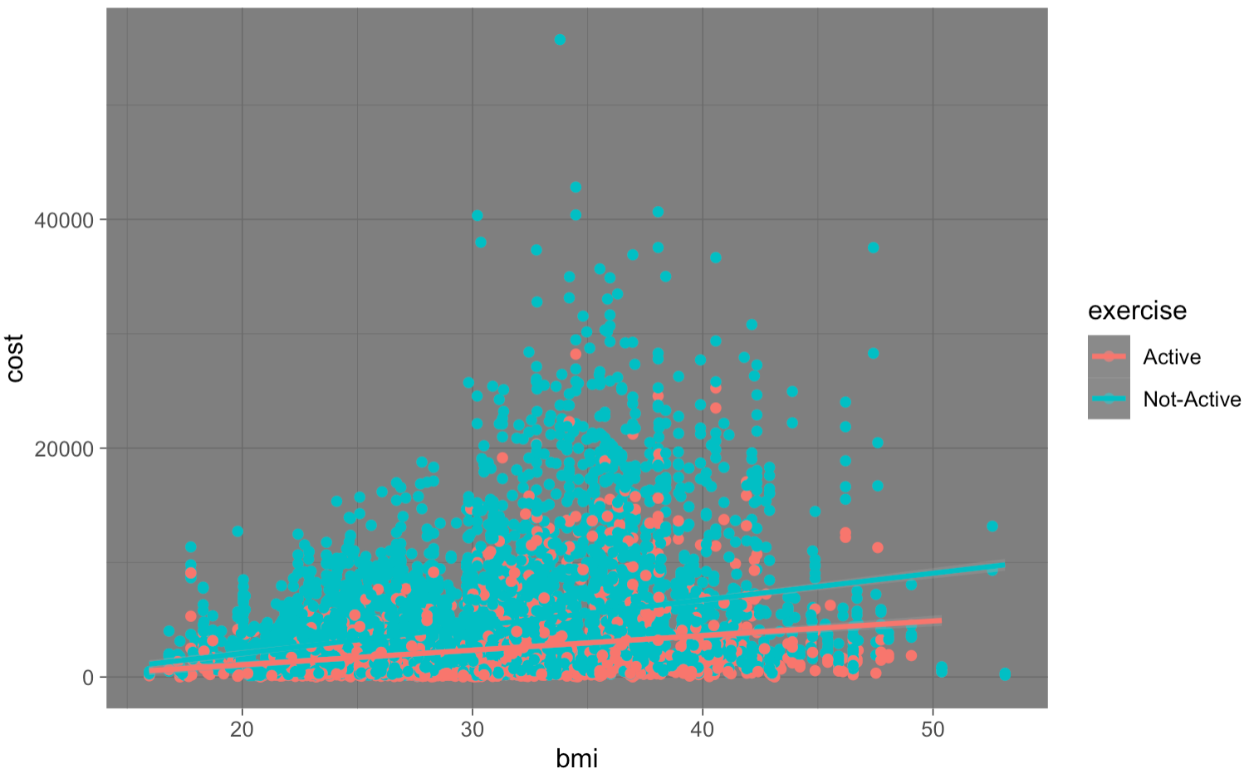
Insights
BMI vs Cost
Smokers
Exercise

Slide 7
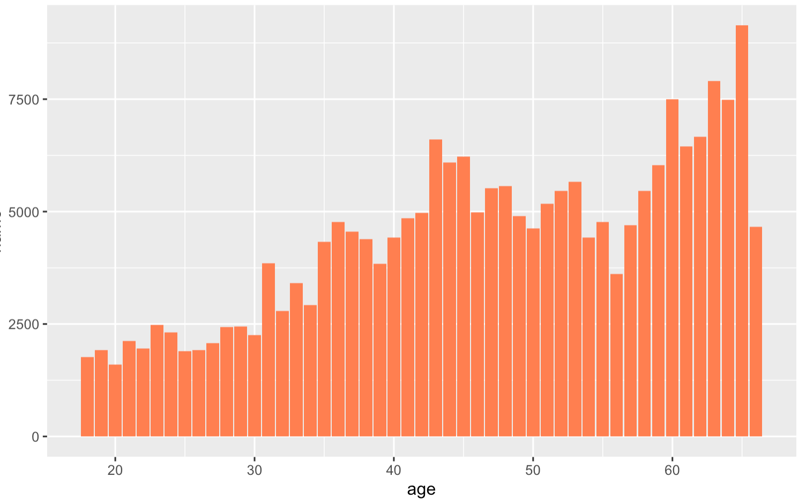
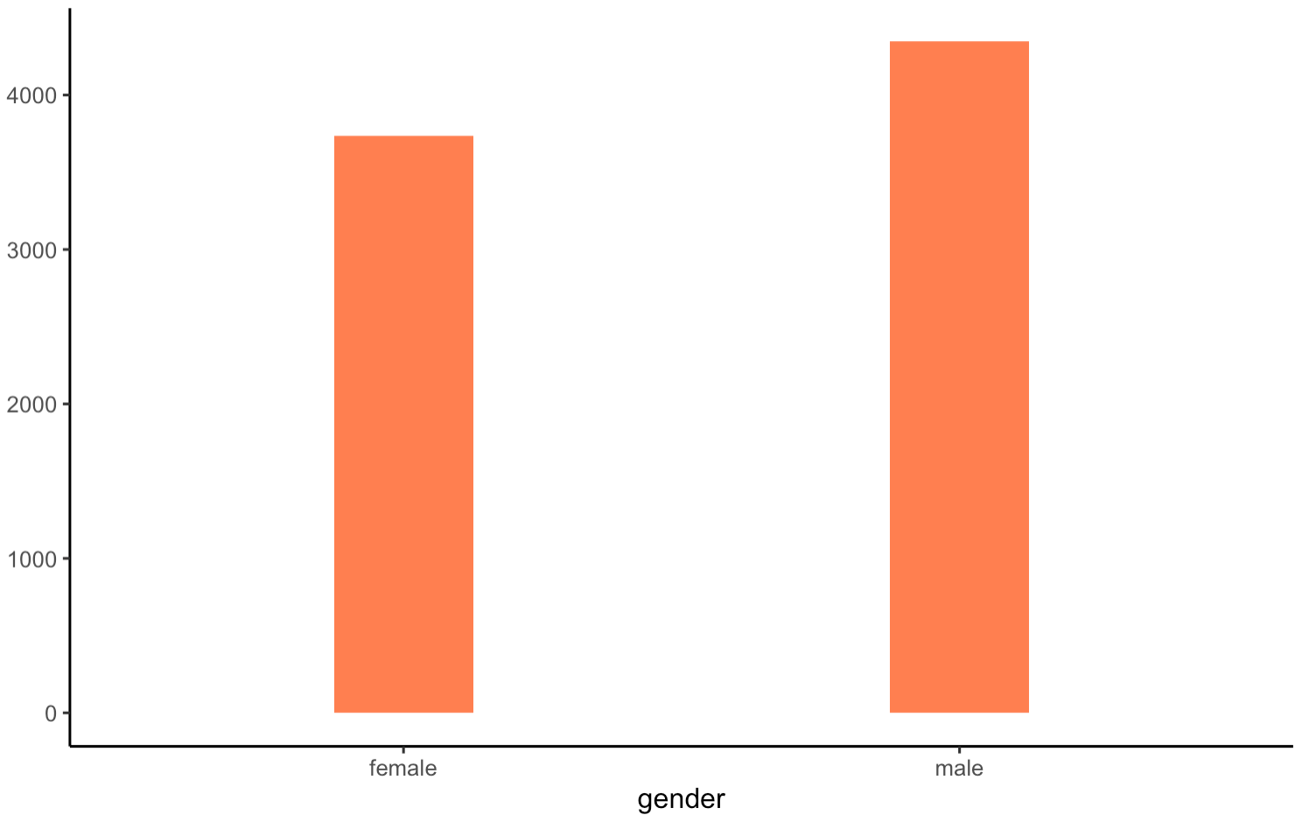
Insights
Avg Cost by Age
Avg Cost by Gender

Slide 8
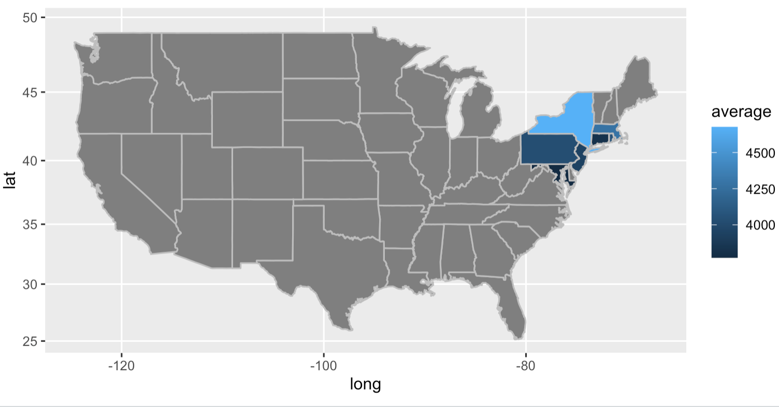
Insights
State | Avg Cost
New York | 4676
Massachusetts | 4285
Rhode Island | 4075
Pennsylvania | 4032
New Jersey | 3942
Connecticut | 3823
Maryland | 3772

Slide 9
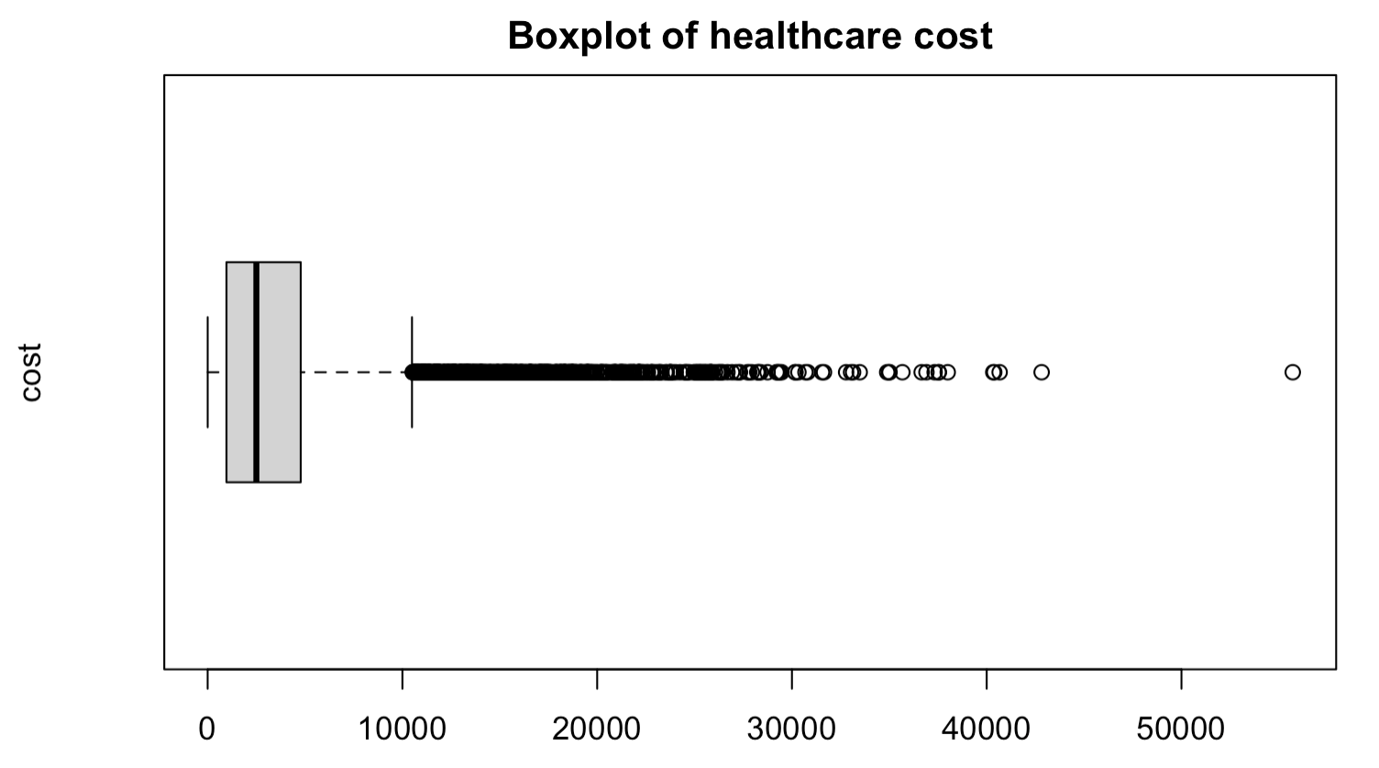
Looking at cost spread
Stat | Values
Minimum | 2
1st Q | 966
Median | 2500
3rd Q | 4779
Maximum | 55715

Slide 10
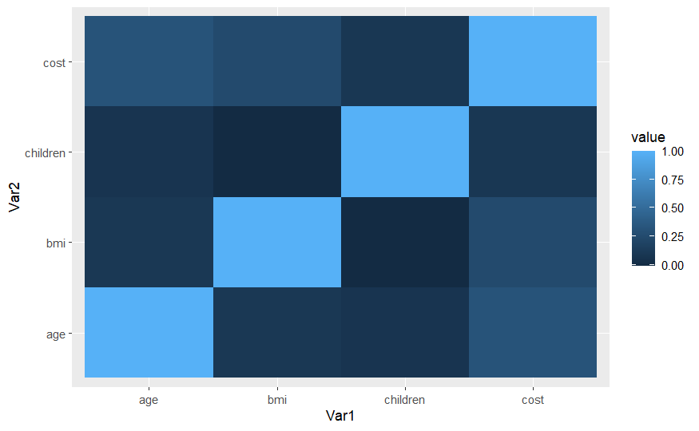
Numerical Factors Affecting Cost
 | Age | BMI | Children | Cost
Age | 1.00 | 0.10 | 0.07 | 0.32
BMI | 0.10 | 1.00 | -0.01 | 0.25
Children | 0.07 | -0.01 | 1.00 | 0.09
Cost | 0.32 | 0.25 | 0.09 | 1.00

Slide 11
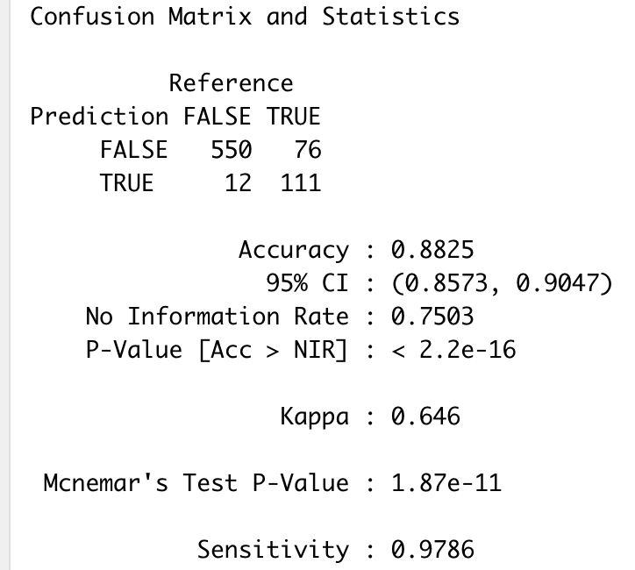
Are we able to predict if an individual has expensive health care costs ?
Yes, we were able to develop a model to accomplish this goal.
From the insights generated identifies Smoker, Exercise, Age and BMI to have positive correlation with Cost.
Using these variables developed multiple models SVM (support vector machine) model and Regression Tree model.
We were able to predict 98 % of actual expensive individuals as expensive.

Slide 12
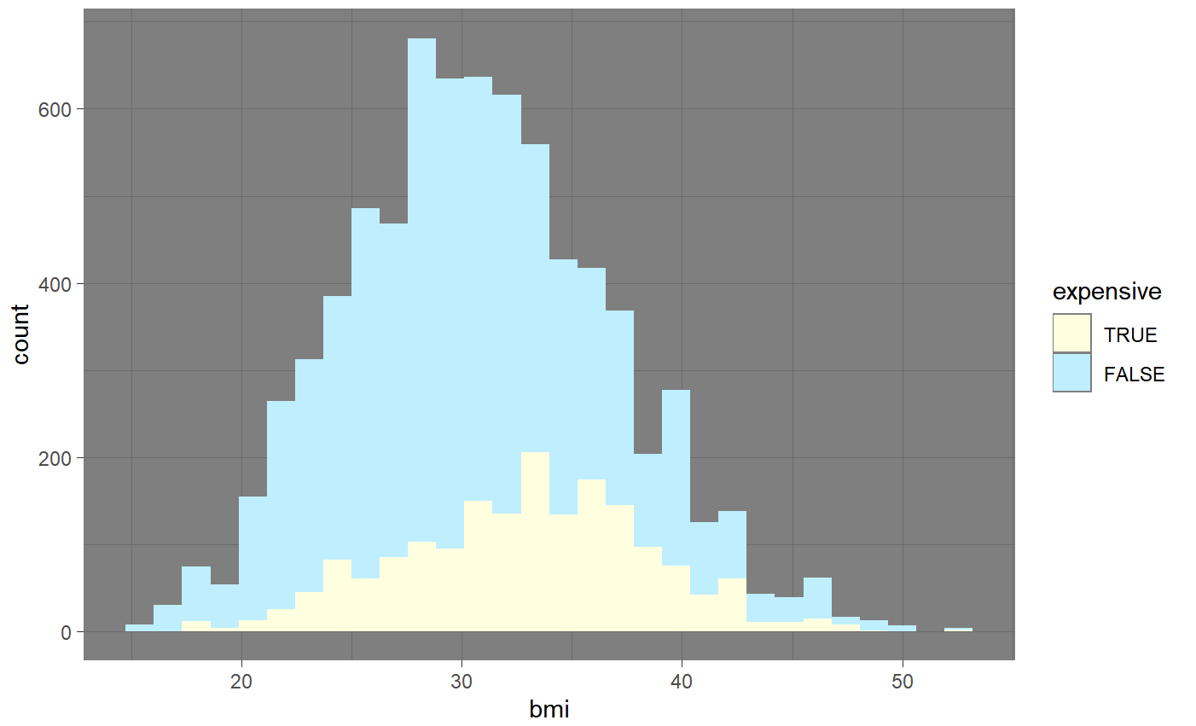
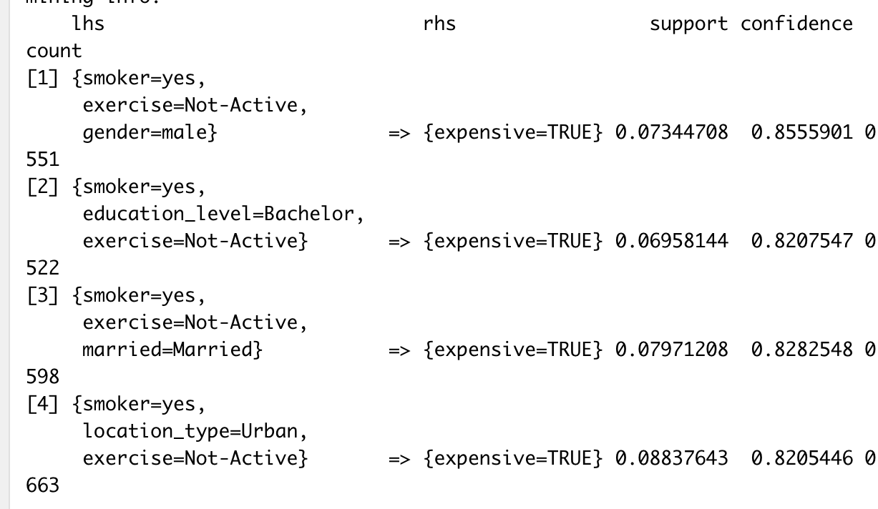
Recommendations
Promoting regular health check up for senior citizens. (above age 55, offering 1 free check up a year)
Promoting fit lifestyle and controlling weight (marathons conducted by the HMO).
Anti Smoking programs.
Higher Premium for customers who are predicted to have high health care cost or state depend.

Slide 13
Thank You !

